Slide 1
Data Visualization of Bird Strikes between 2000 – 2011
Submitted by:
Rudrani Ghosh
UNID: UM/IP/1276
College: M.Sc. Data Science at VIT, Vellore

Slide 2
Problem Statement
The problem revolves around the analysis of bird strikes, defined as collisions between birds and aircraft during flight, take-off, or landing. Bird strikes pose a significant threat to aircraft safety, potentially causing structural damage and engine failures, leading to fatal accidents. The analysis focuses on data collected by the FAA between 2000-2011. Key aspects include visualizing the number of bird strikes, yearly analysis, top airlines and airports affected, cost incurred, timing and altitude of strikes, flight phase during strikes, impact on flight, and the relation between pilot warnings and strike effects.

Slide 3
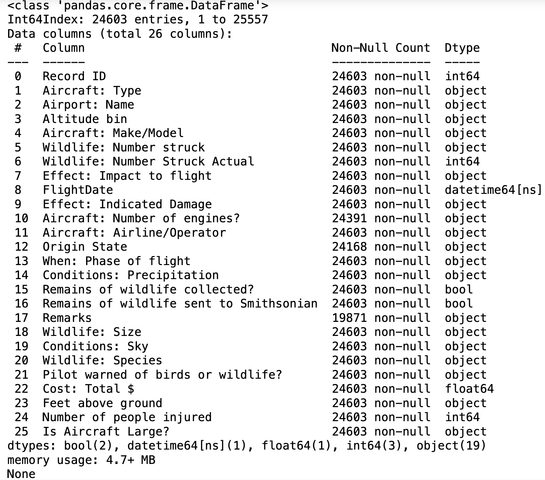
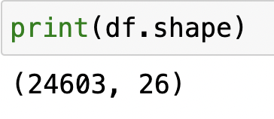
Details of Data
Year range: 2000 to 2011
No of Rows: 24603
No. of columns: 26

Slide 4
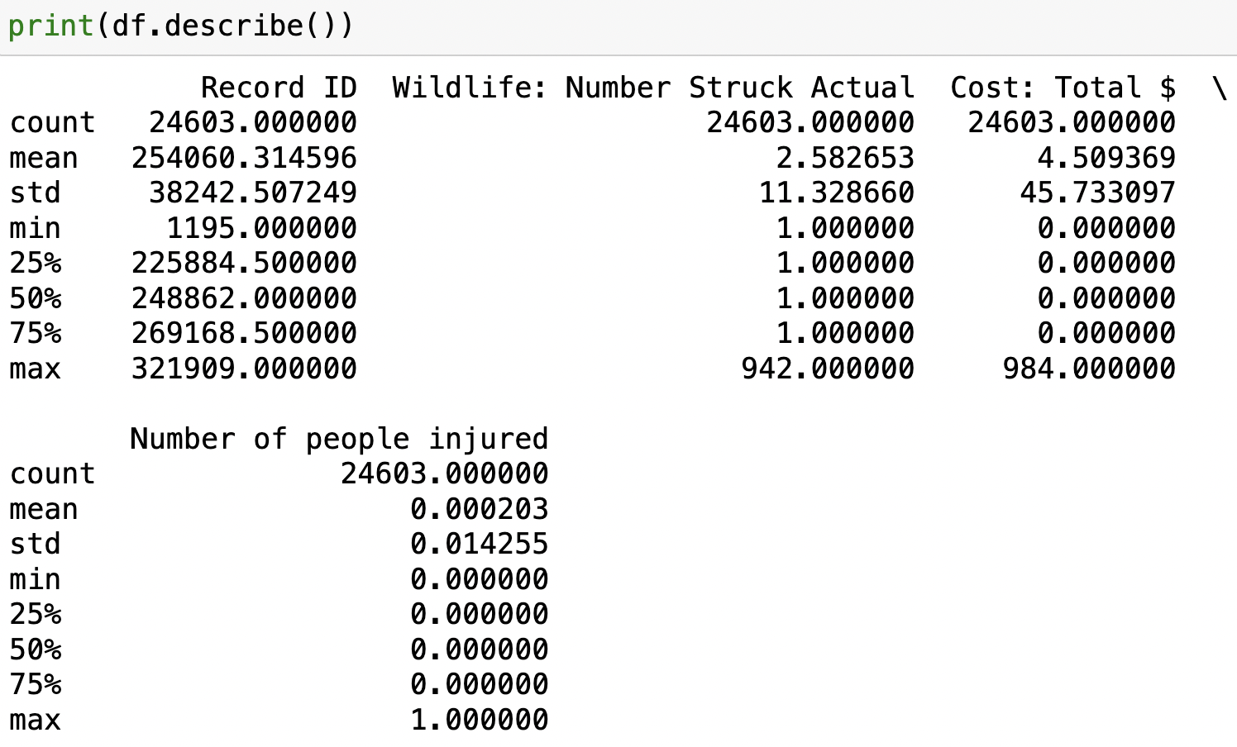

Slide 5
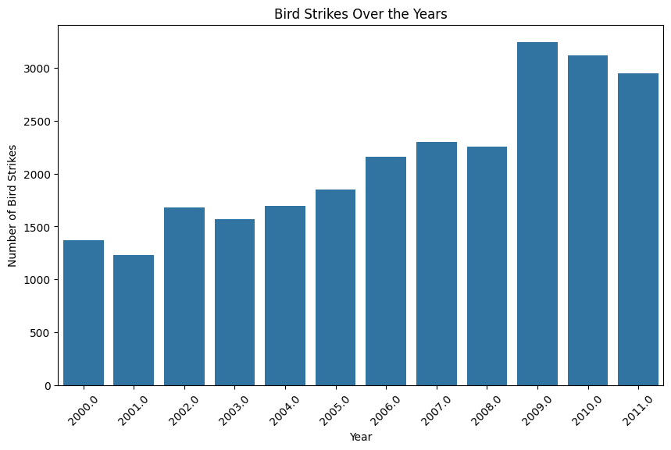
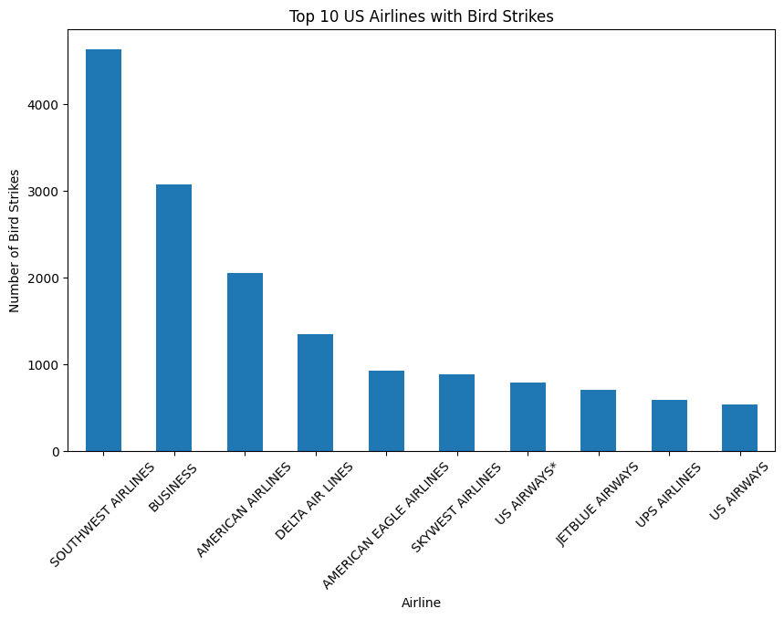

Slide 6
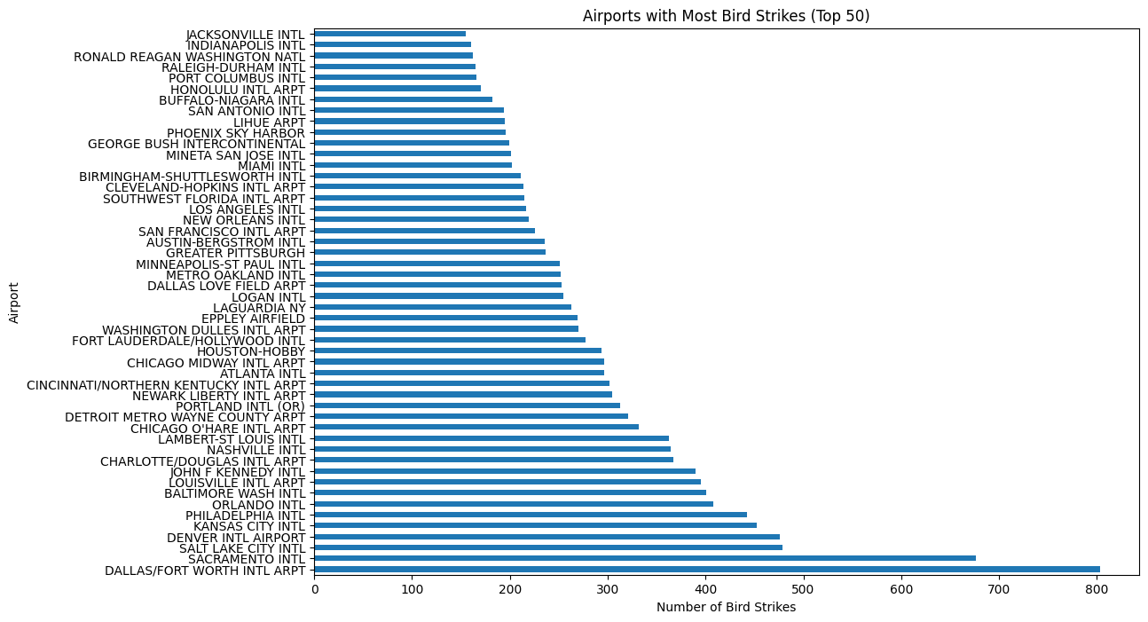
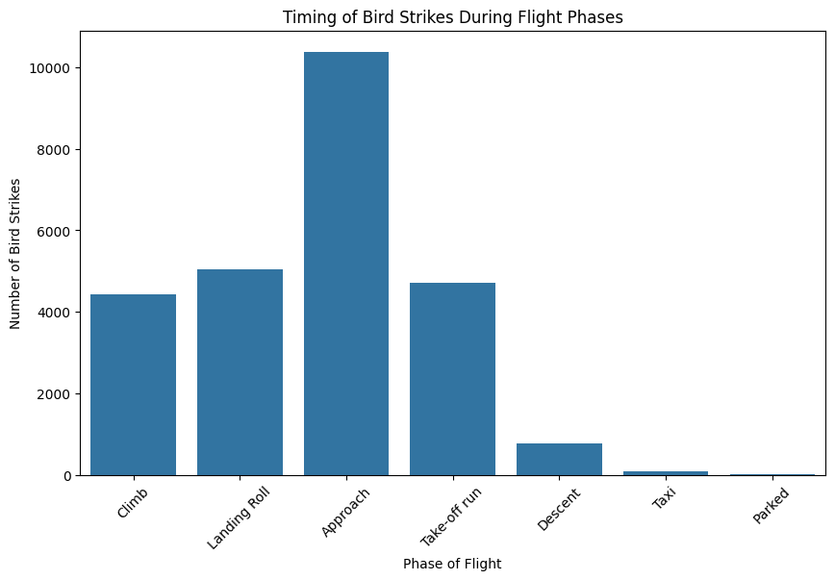
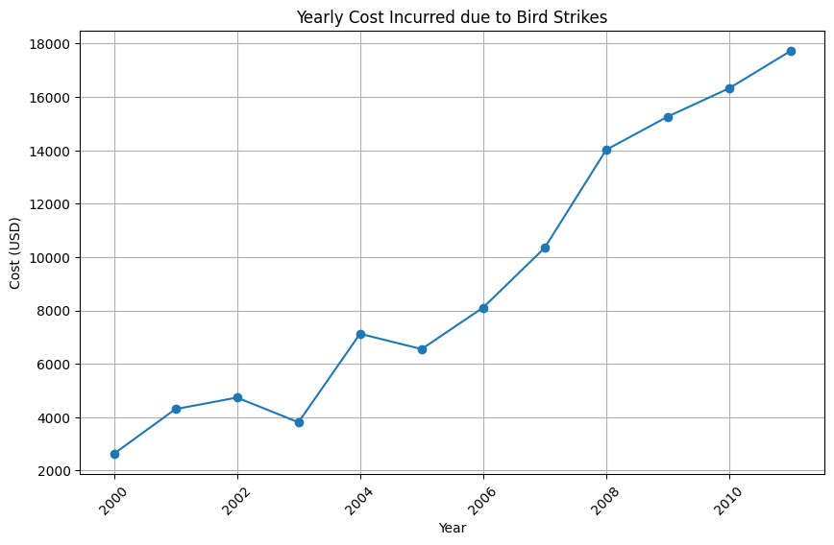

Slide 7
Main KPIs
Key Performance Indicators (KPIs) are metrics used to evaluate the performance and effectiveness of a particular process or activity. In the context of analyzing bird strikes, several KPIs can be identified based on the problem statement provided:
Number of Bird Strikes
Yearly Cost Incurred due to Bird Strikes
Top 10 US Airlines by Bird Strike Encounters
Airports with Most Incidents of Bird Strikes
Timing of Bird Strikes
Altitude of Airplanes at Time of Strike
Phase of Flight at Time of Strike
Effect of Bird Strikes & Impact on Flight
Effect of Strike at Different Altitude
Pilot Warning and Effect of Strike Relation

Slide 8
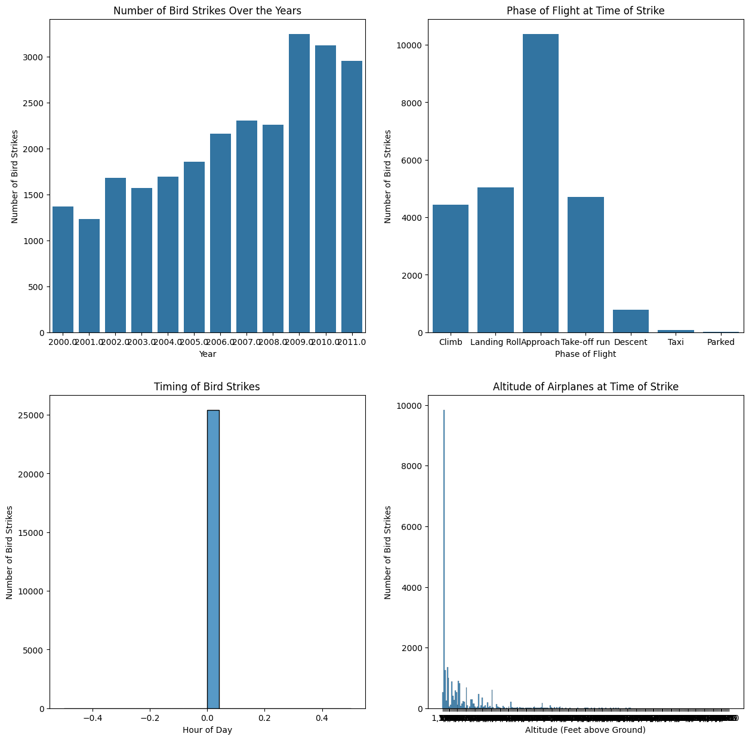

Slide 9
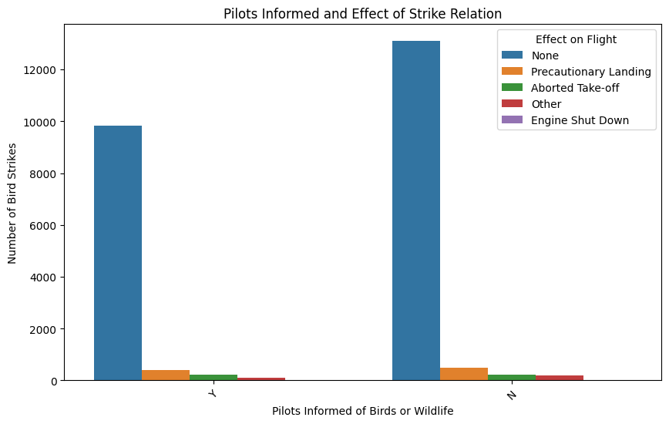

Slide 10
Thank you

